Slide 1

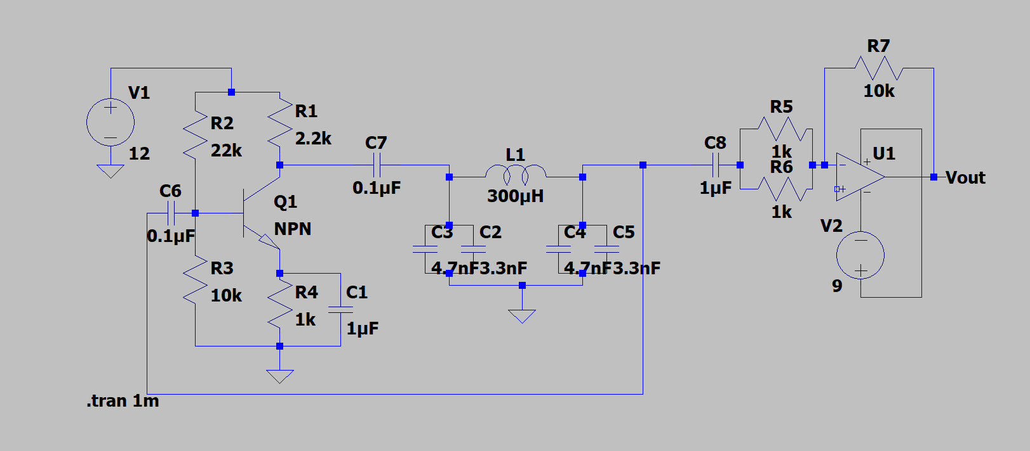
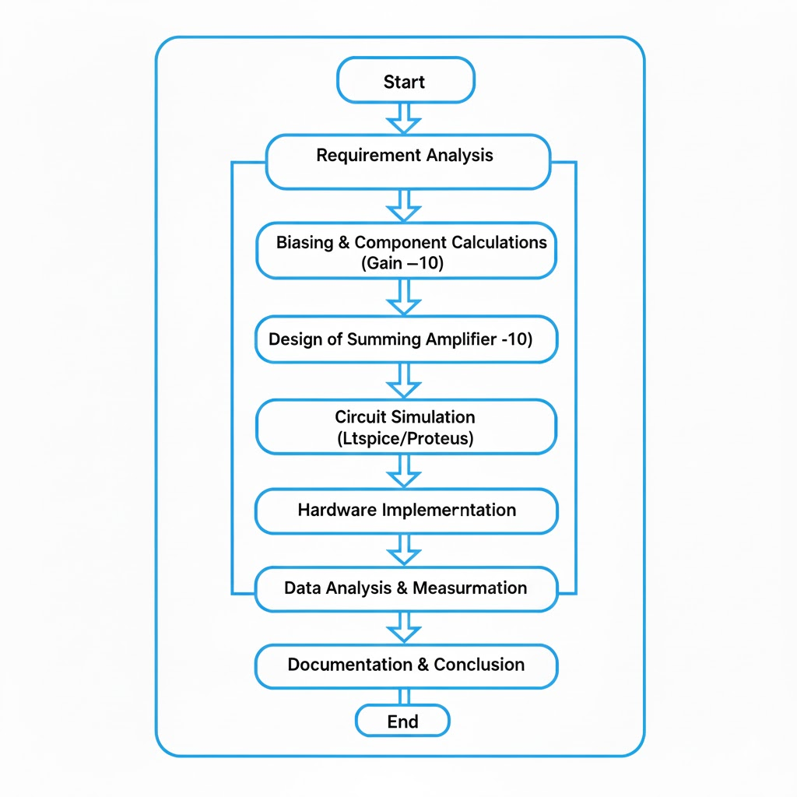
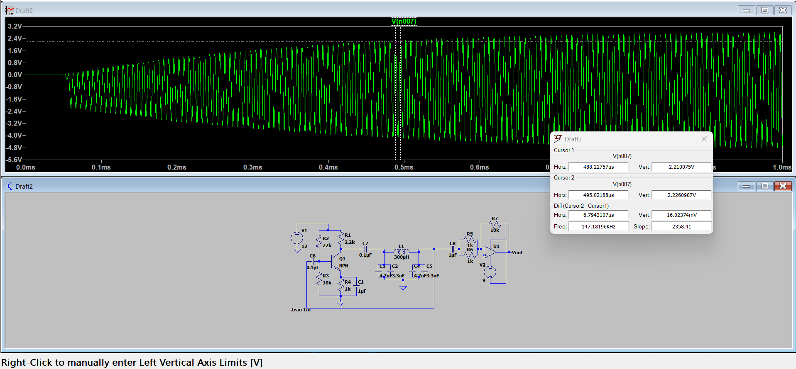
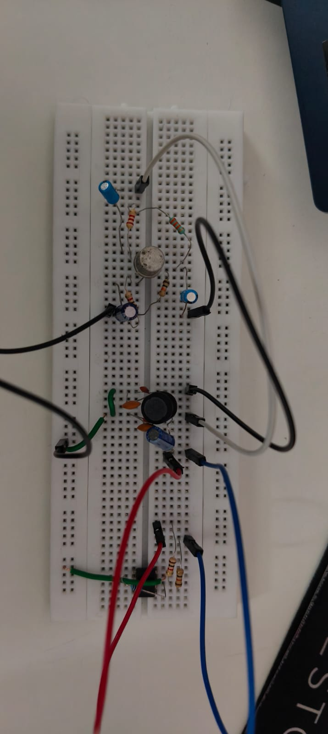
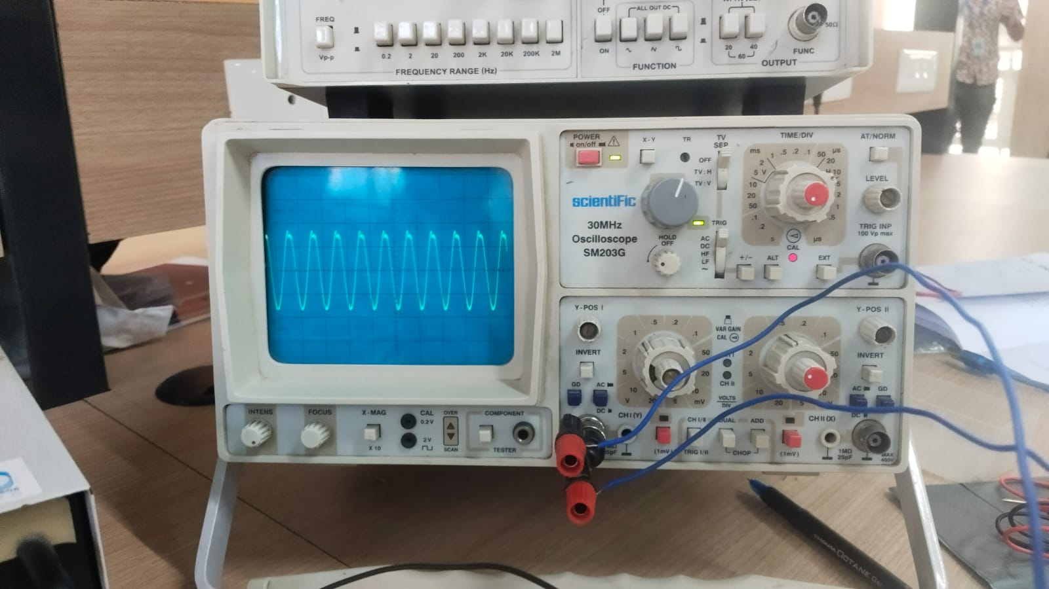
RV College of Engineering
"Colpitts oscillator with frequency 150 kHz, summing amplifier with gain –10.
Go, change the world
Anurag-1RV24EC031 Amrut R-1RV24EC025
Bhavesh S-1RV24EC044
Department of Electronics and Communication Engineering
RV College of Engineering, Bangalore – 560059, INDIA
OBJECTIVE
"Implement a Colpitts oscillator at 150 kHz, then feed its output to a summing amplifier with gain –10. Measure: Oscillation frequency, summed/amplified output, and distortion.”
Methodology
LTSpice Simulation Software: Used to simulate the working of the circuit before implementation
Power Supply (DC): Used to provide the operating voltages of the transistor and op-amp
Digital Multimeter (DMM): Used to measure the biasing Voltages of the transistor, to ensure the biasing is done properly.
Breadboard: Used to assemble the test circuit.
Oscilloscope (CRO/DSO): Used to measure the output signal and its characteristics
Function Generator: To test the working of the summer circuit
Results and Discussions
The above represents the testing phase of the project where the circuit was first designed on Ltspice
The simulated circuit was then tested on the Ltspice software to see if the required oscillations were obtained
Design specifications
1. Transistor Configuration & Biasing
Active Element: CL100S NPN Medium Power Transistor.
Biasing Scheme: Voltage Divider Bias.
2. Tank Circuit Design (150 kHz Resonance)
Inductor: Axial Inductor. Chosen for a higher Quality Factor
Capacitor : (Implemented as in parallel).
Bypass Capacitor: Electrolytic.
Role: Filters high-frequency noise and stabilizes the rail against power supply fluctuations.
3.Summing circuit(-10 gain)
LM358/TL082 Op amp
Resistors: provides the necessary –ve feedback.
4. Design Outcome
Calculated Frequency: .
Performance: High spectral purity with stable peak-to-peak amplitude, optimized for low-impedance interfacing with the following Op-Amp stage.
Testing of the oscillator circuit on a bread board
Sustained oscillations of the oscillator
Conclusions
The design, simulation, and hardware implementation of the 150 kHz signal generation and conditioning system were successfully executed, fulfilling all primary and technical objectives.
In conclusion, the successful deployment of this cascaded system validates the efficacy of discrete BJT oscillators and JFET-input amplifiers in high-frequency applications. The project effectively bridged the gap between theoretical calculations and practical hardware constraints, resulting in a robust, functional, and accurately characterized electronic system.
Acknowledgements
We thank the respected Hod and the supportive faculty of the Electronics and Communication Dept, for their immense support and guidance in the completion of this project.
Guide Information:
Dr. Harsha, Assistant Professor
Dr. Srividya P, Associate Professor

